Slide 1
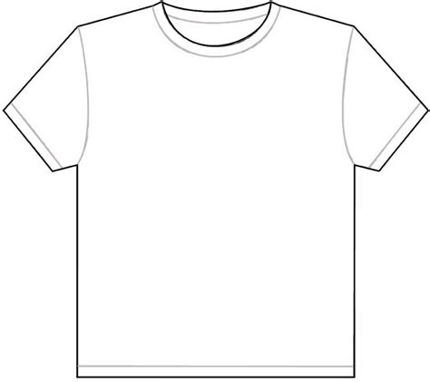
Spring for Scholars T-shirt Design Contest We need your help to design our Spring for Scholars t-shirt. Spring for Scholars is a fundraising event to raise money for scholarships for senior students. Please draw your t-shirt design below and submit your entry to the office by April 1st, 2022 or email copy to g-hscholarship@hotmail.com Feel free to ask for help from family and friends! One winner will be chosen and will receive a State Theatre gift certificate!

